Slide 1
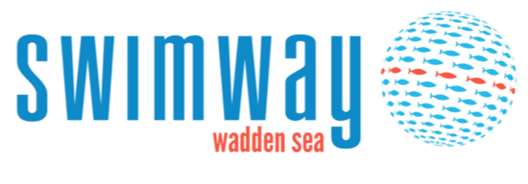
Trilateral Wadden Sea
Swimway Vision
2018 -2024

Slide 2
Trilateral Fish targets
Viable stocks and natural reproduction
Natural occurrence and abundance
Favourable living conditions
Diversity of natural habitats
Maintaining and restoring fish migration passages

Slide 3
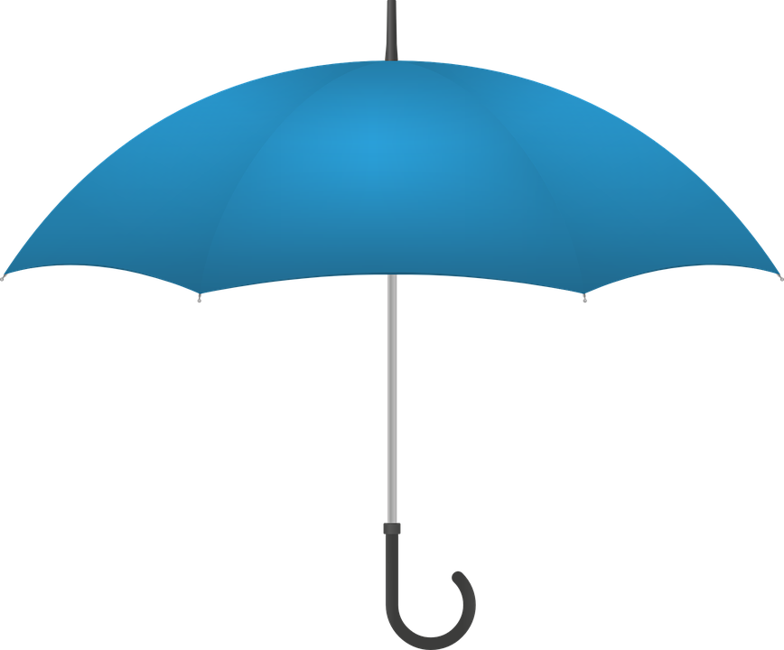
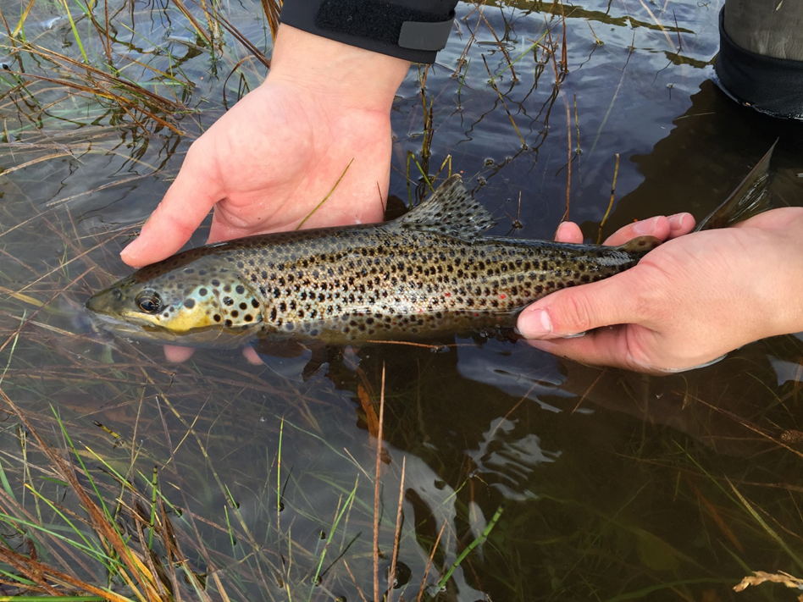
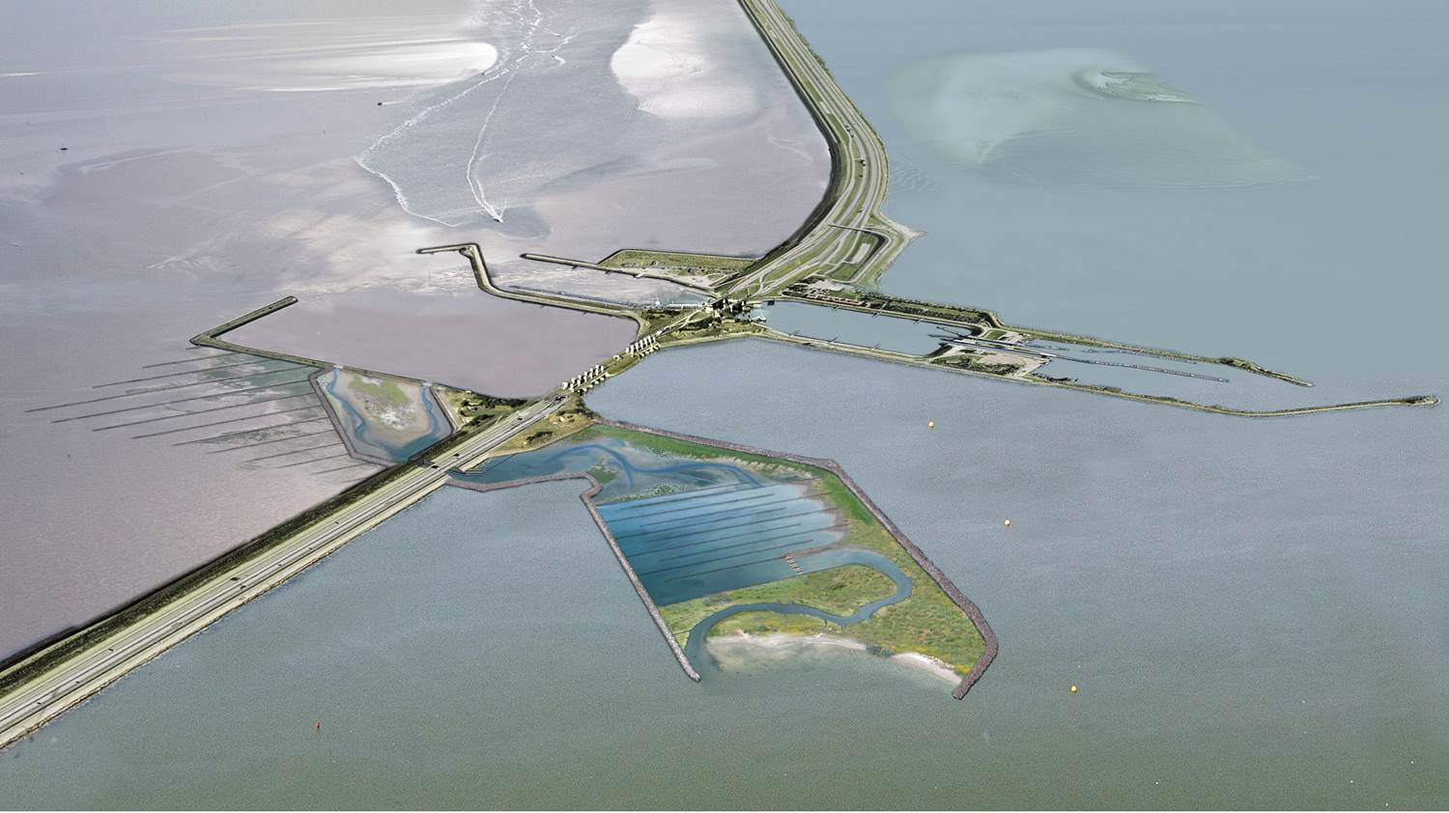
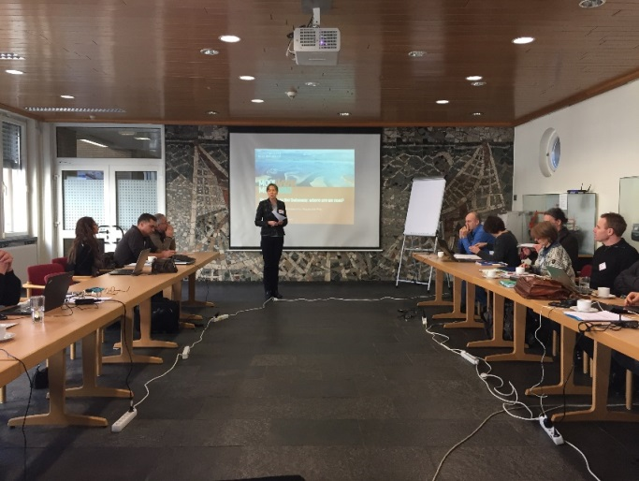
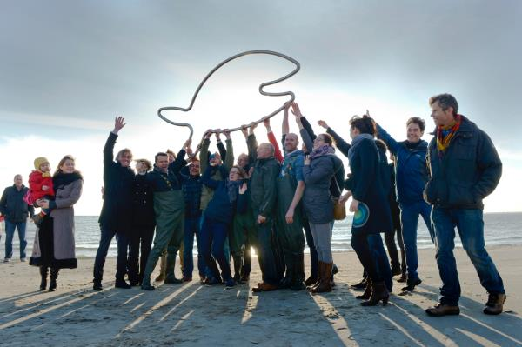
Onderzoek en monitoring
Maatregelen
Beleid
Communicatie

Slide 4
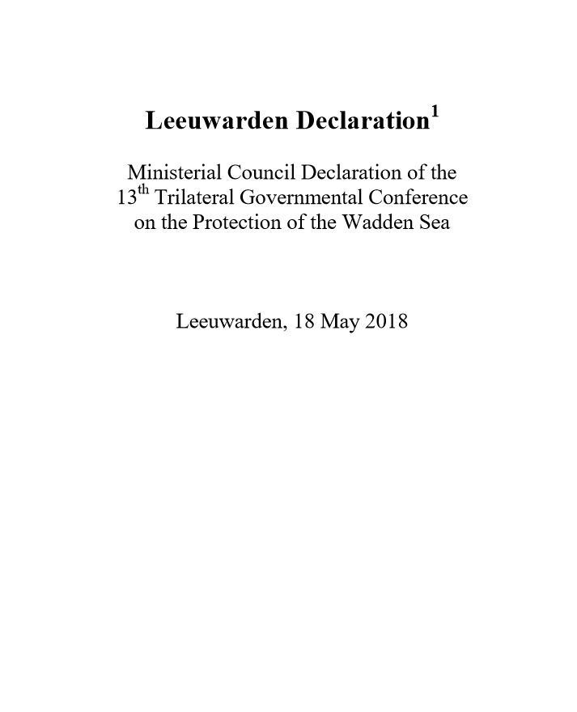
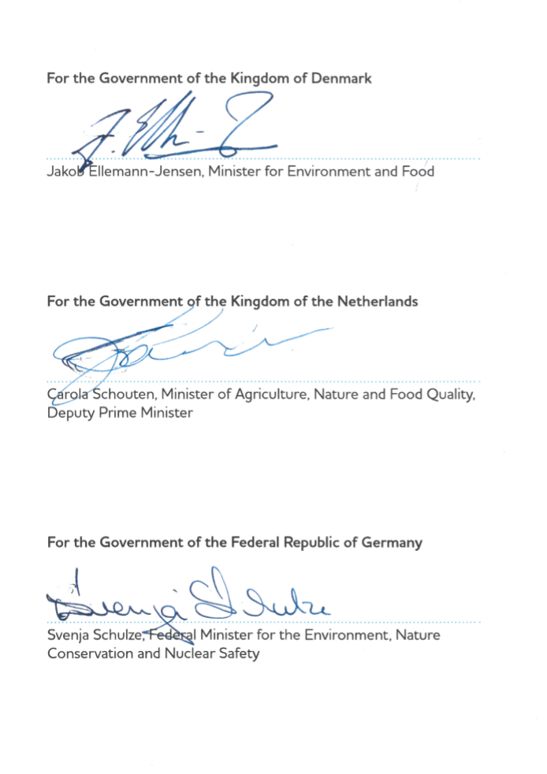
13. Instruct the Wadden Sea Board to further develop and contribute to implementing the SWIMWAY Vision (at Annex 3) as an integrated approach to achieving the Trilateral Fish Targets by investigating, monitoring, managing and communicating topics concerning the ecology of fish of the Wadden Sea Area;

Slide 5
Ondersteund door 25 organisaties uit Duitsland, Denemarken en Nederland
,
Notes:
We are therefore very proud of the large number of organisations from Denmark, Germany and the Netherlands who support the Swimway Wadden Sea Vision. Their signatures and logos are presented on the following slides.
I sincerely hope that at the next trilateral conference we can present some of our achievements and a lot more happy fishes.

Slide 6








Slide 7



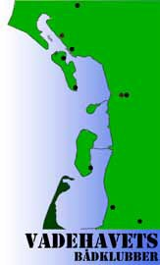




Slide 8





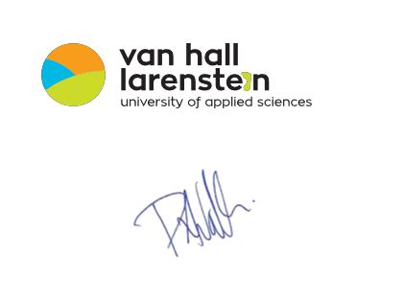

Slide 9





Slide 10
Vervolg trilateraal
Uitvoeren actieprogramma
Trilaterale coordinator
Trilateraal project: beheer ?
Trilaterale Swimway Summit
Stakeholders
Fish expert group

Slide 11
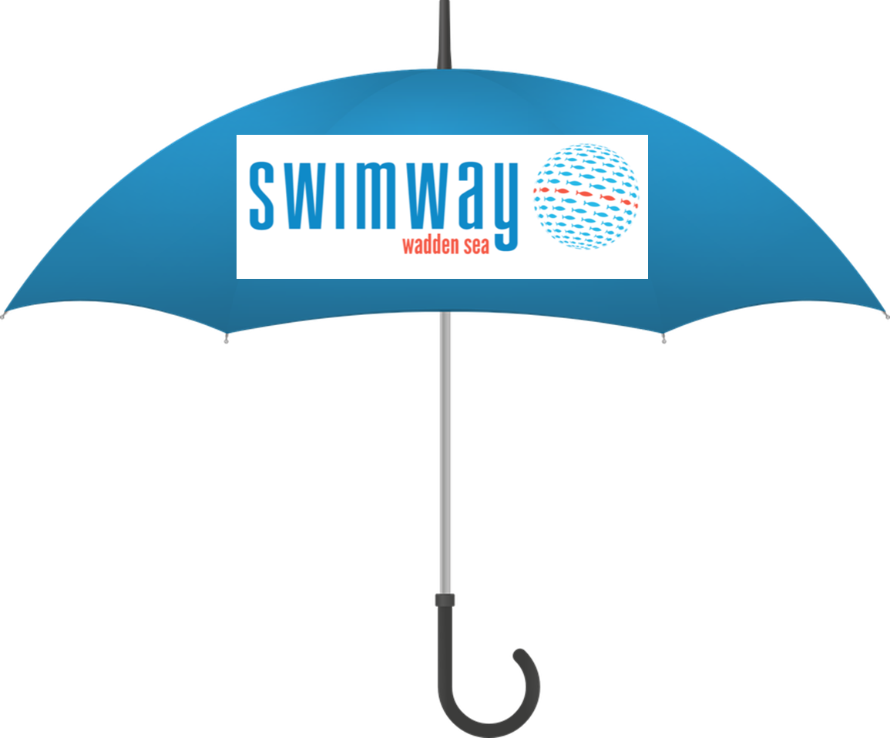
Vervolg Nederland
Participeren trilateraal
Stakeholderbijeenkomsten
Inventarisatie projecten en initiatieven

Slide 12
Wat valt op
Grote aanvragen onderweg richting Waddenfonds
Coördinatie van algemene monitoring via Basismonitoring
Veel maatregelen genomen en in voorbereiding gericht migratie
Geen beleidskwesties
Communicatie/educatie wadden breed, niet specifiek vis
Beheerkwesties onderbelicht

