Slide 1
How to become a dark sky park
Workshop B

Slide 2
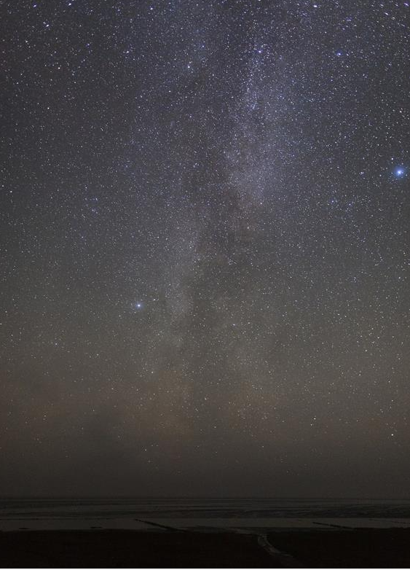
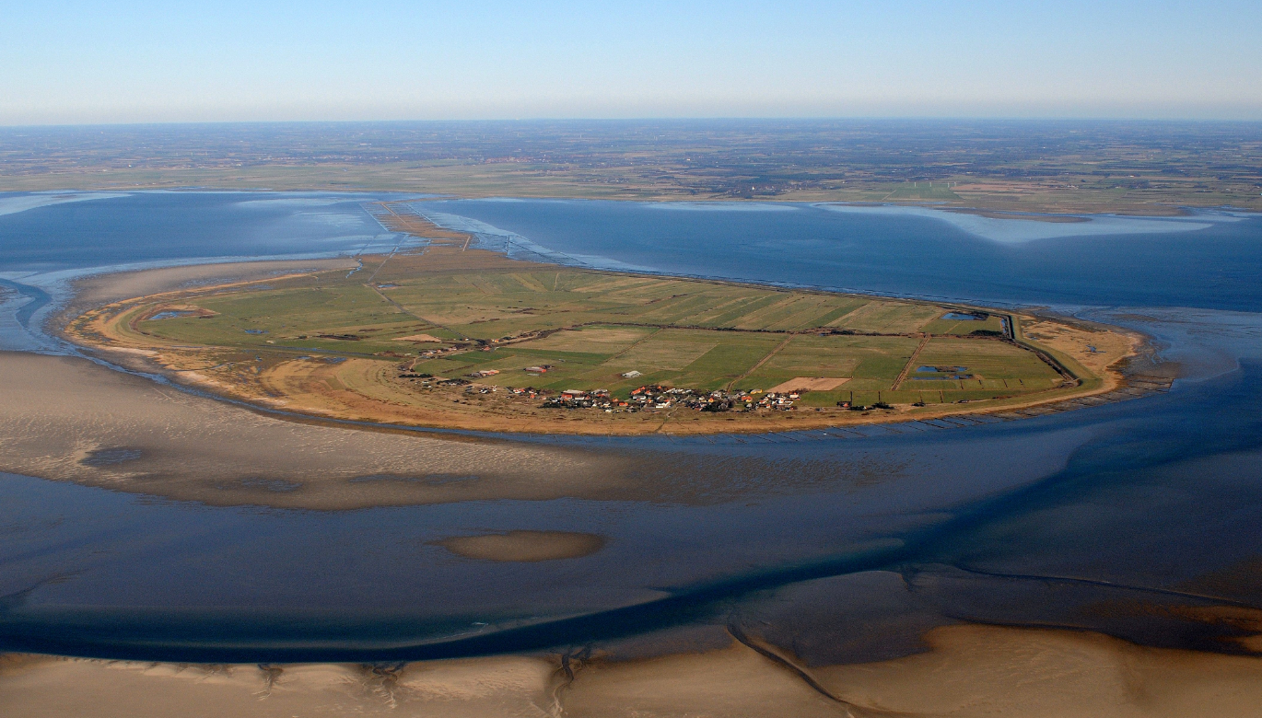
The island of Mandø
7,63 km²
32 inhabitants/about 100.000 tourist per year
Only way to the island is a road on the seabed which is flooded 2 times a day
Nature restauration project alltogether about 220 acres primarily for meadow birds
Billede taget af John Frikke
Notes:
Velkommen
3
Short introduction of the place and our team
And the a few slides before dialoug

Slide 3
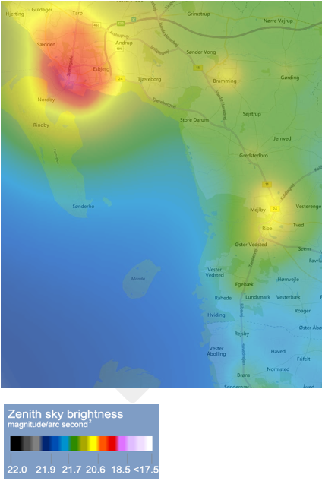
3 partners teaming up
The Locals
Municipality of Esbjerg
Nationalpark Wadden Sea
Sharing the same goals
  To protect the OUV of the
  Wadden Sea
  Sustanible tourism including
  dissemination and teaching in
  the benefit of darkness
  Sustanible development of the island
Notes:
Different perspectives

Slide 4
Municipality of Esbjerg
We initiate the proces and is the project manager for the proces of writing the application for the IDA to become Dark Sky Park
We secure the political support and the formalities of the application fx the preparation and the adoption of the light management plan
We secure the involvement of the many other partners who are essential for making the Dark Sky Park Mandø e.g. University of Aarhus, Amateur Astronomical Association, high schools and primary schools, tourist operators and Port Esbjerg
- in respect of a bottom up commitment
Notes:
All together about 20 people
Deklaration i 2018
One of the land owners

Slide 5
3 advices
It is very important to anchor the commitment for the
project in the participants
It is important to engage different perspectives
It is important to have a process manager – the proces
takes time and there are a lot of activities to keep track of

Slide 6
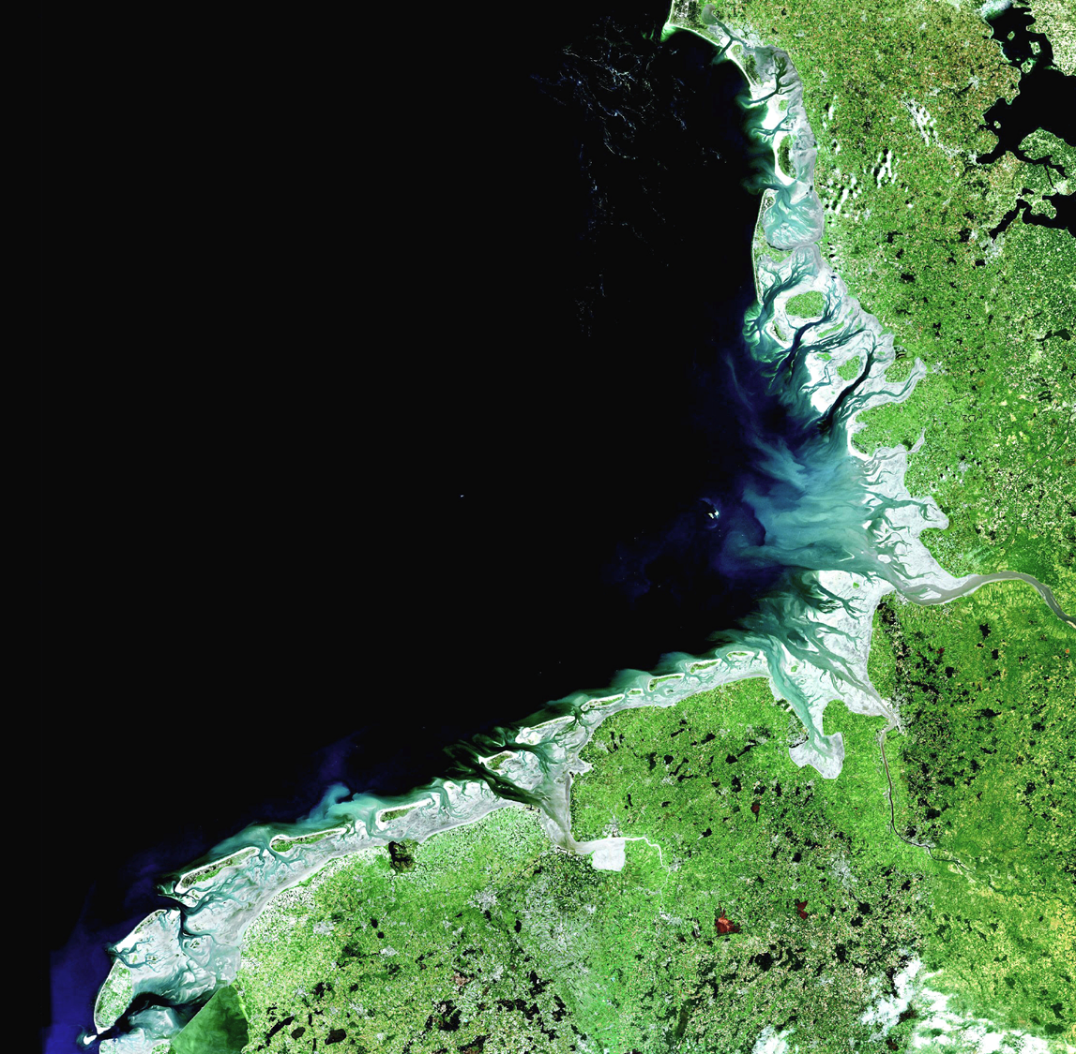
Nationalpark Wadden Sea
Unesco World Heritage with Germany and Netherlands
Dark Sky
- supplement and complement the outstanding universal values
- helps to protect biodiversity
We will work to protect, strengthen and develop nature,
landscape, the geological values and the cultural heritage of the region

Slide 7
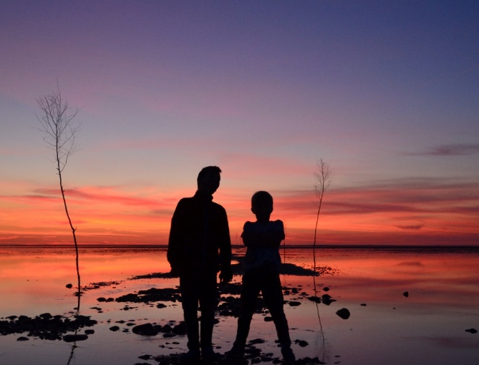
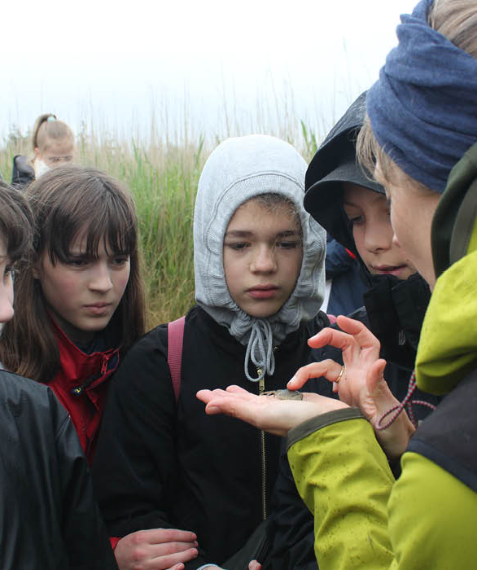

Mit Vadehav – educational platform
Our goal: We will support science, education and interpretation
pertaining to and of the site
Dark Sky
- fits perfectly in the educational program
- well known platform
- ready to use materials made by teachers

Slide 8
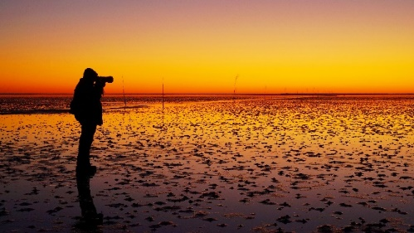
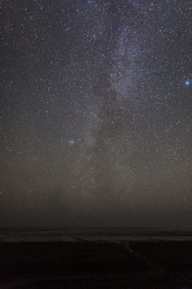
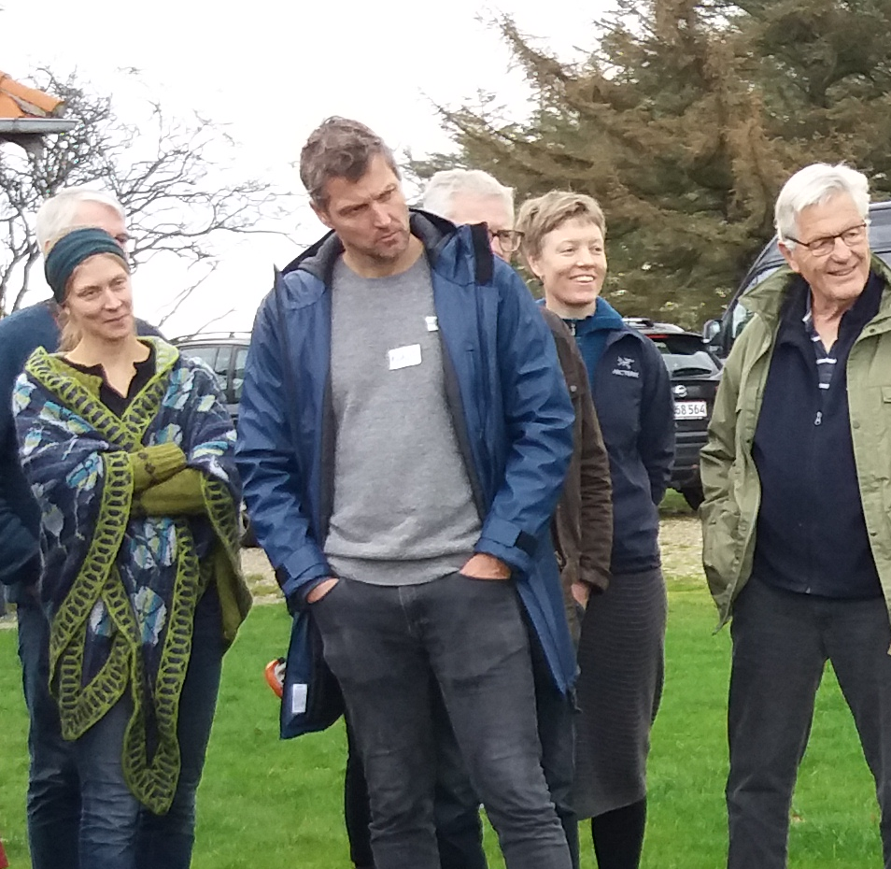
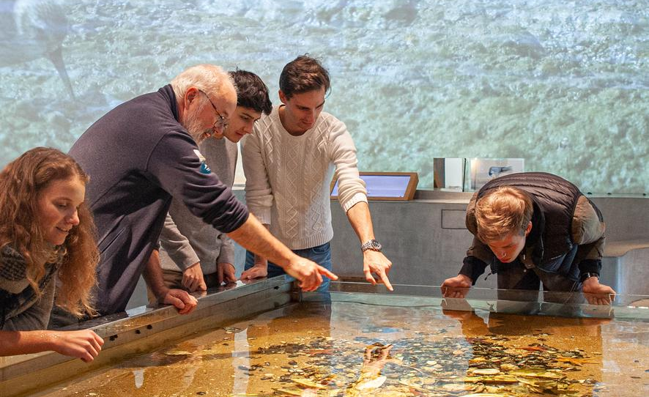


Partner program
Our goal: Our National Park partners are the first
point of contact for visitors and are therefore our most important communication channel.
We will develop new experiences and strengthen their communication and interpretation skills, in collaboration with them
Dark Sky
- training of star guides under the partner program
- possible National Park partnership

Slide 9
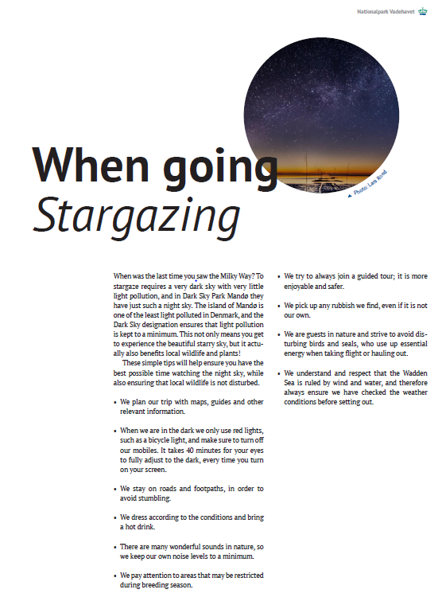
Codes of conduct
Be a good star guest in the dark

