Slide 1
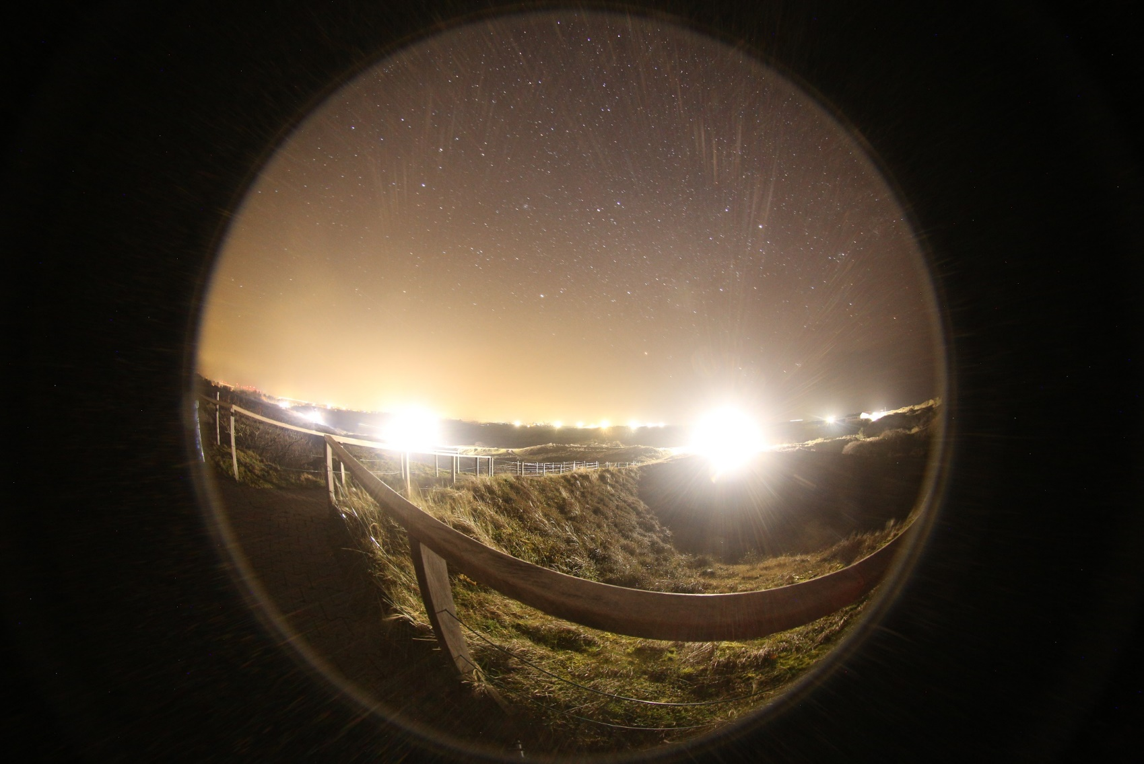


“Reduce light emissions”
- simply let’s just do it!
Webinar “Erlebe die Finsternis”
North Sea coast 2021-04-23
Andreas Hänel
Fachgruppe DARK SKY der VdS
Kommission Lichtverschmutzung Astronomische Gesellschaft

Slide 2
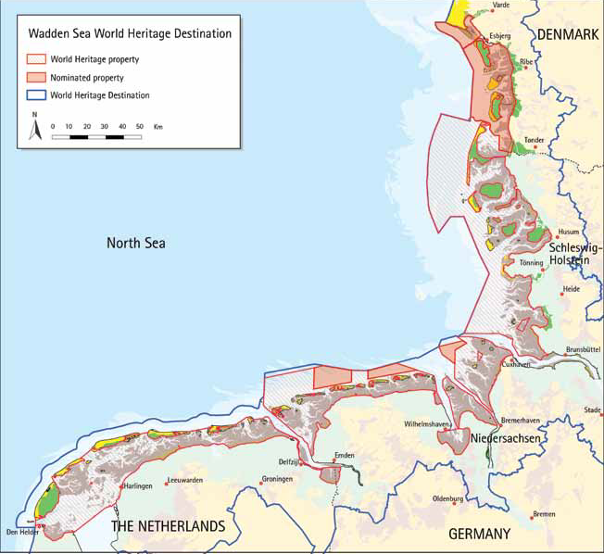
World heritage Wadden Sea
Leeuwarden Declaration, 2018
2

Slide 3
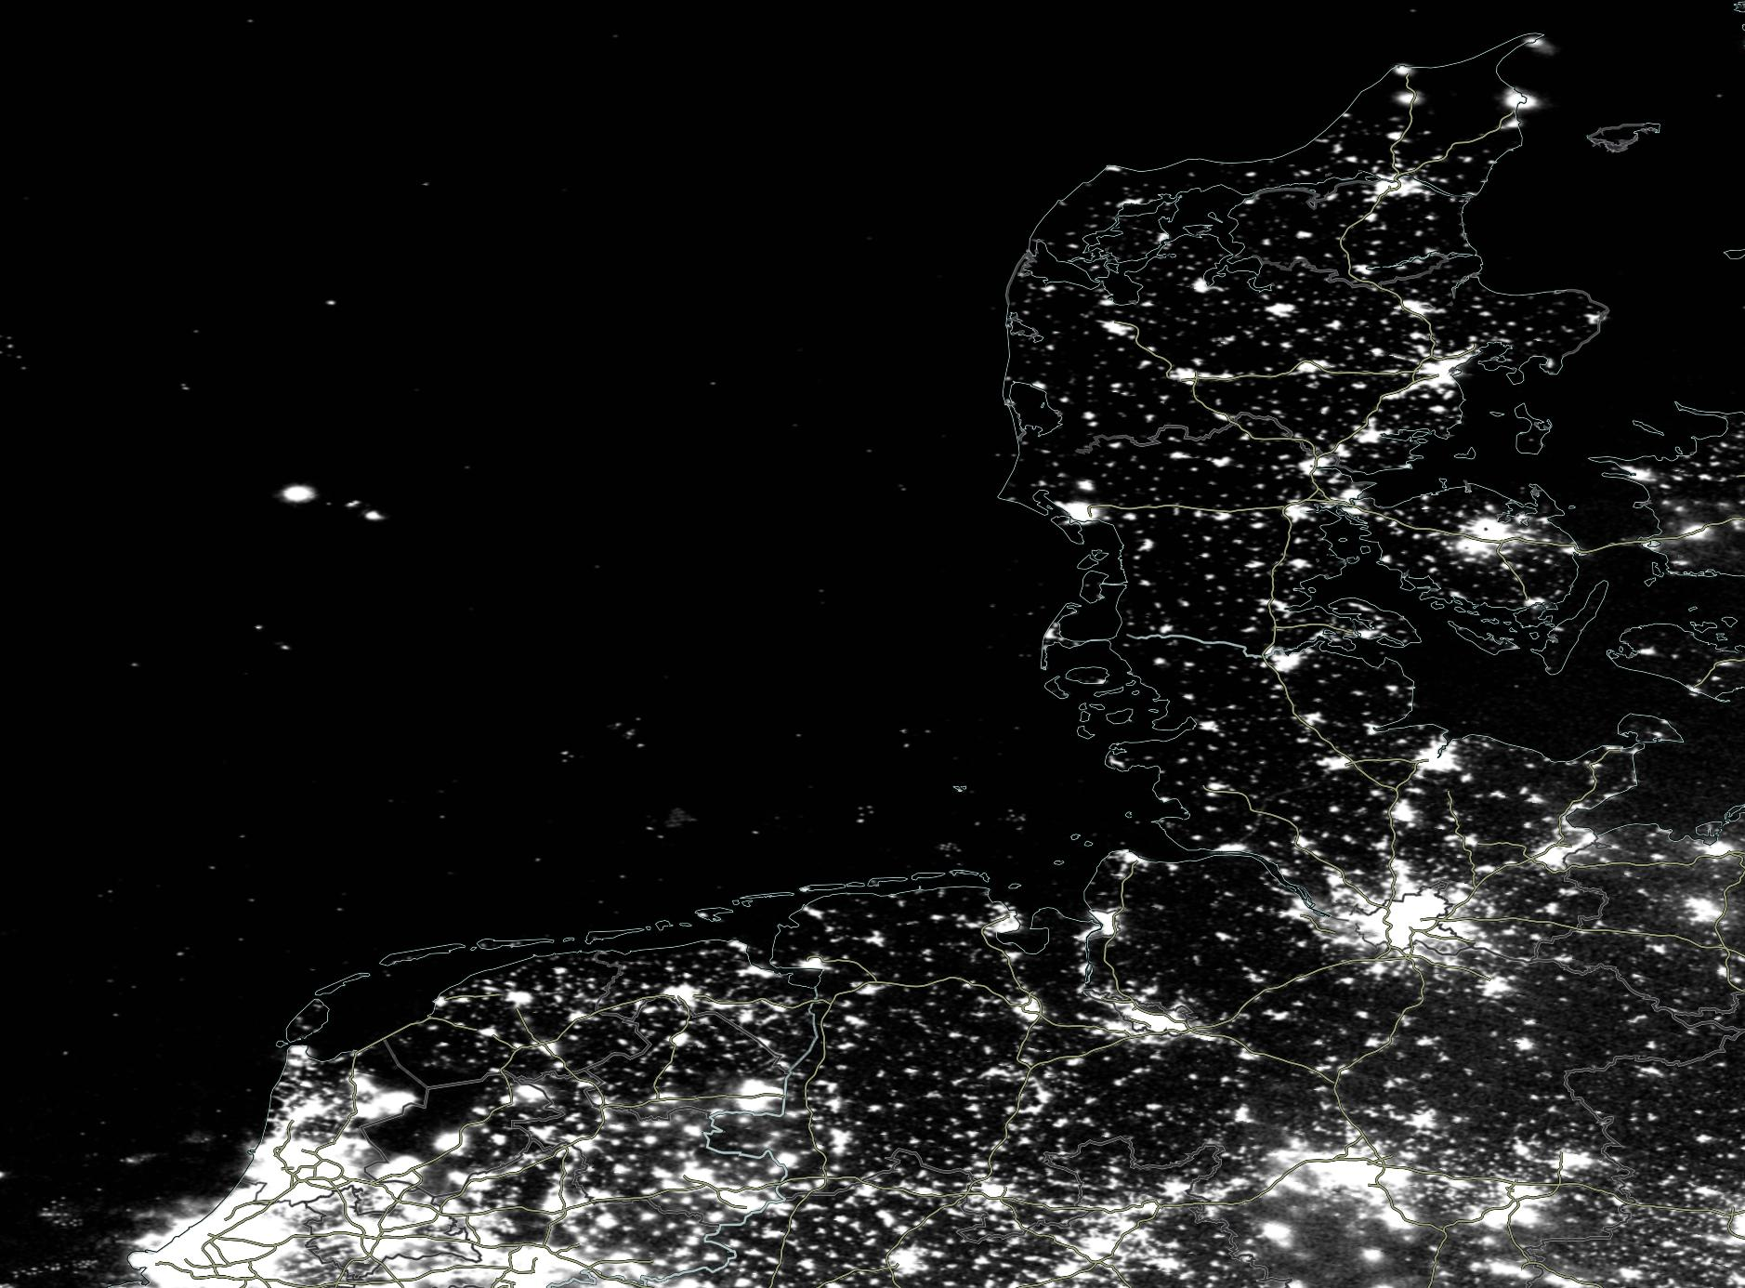
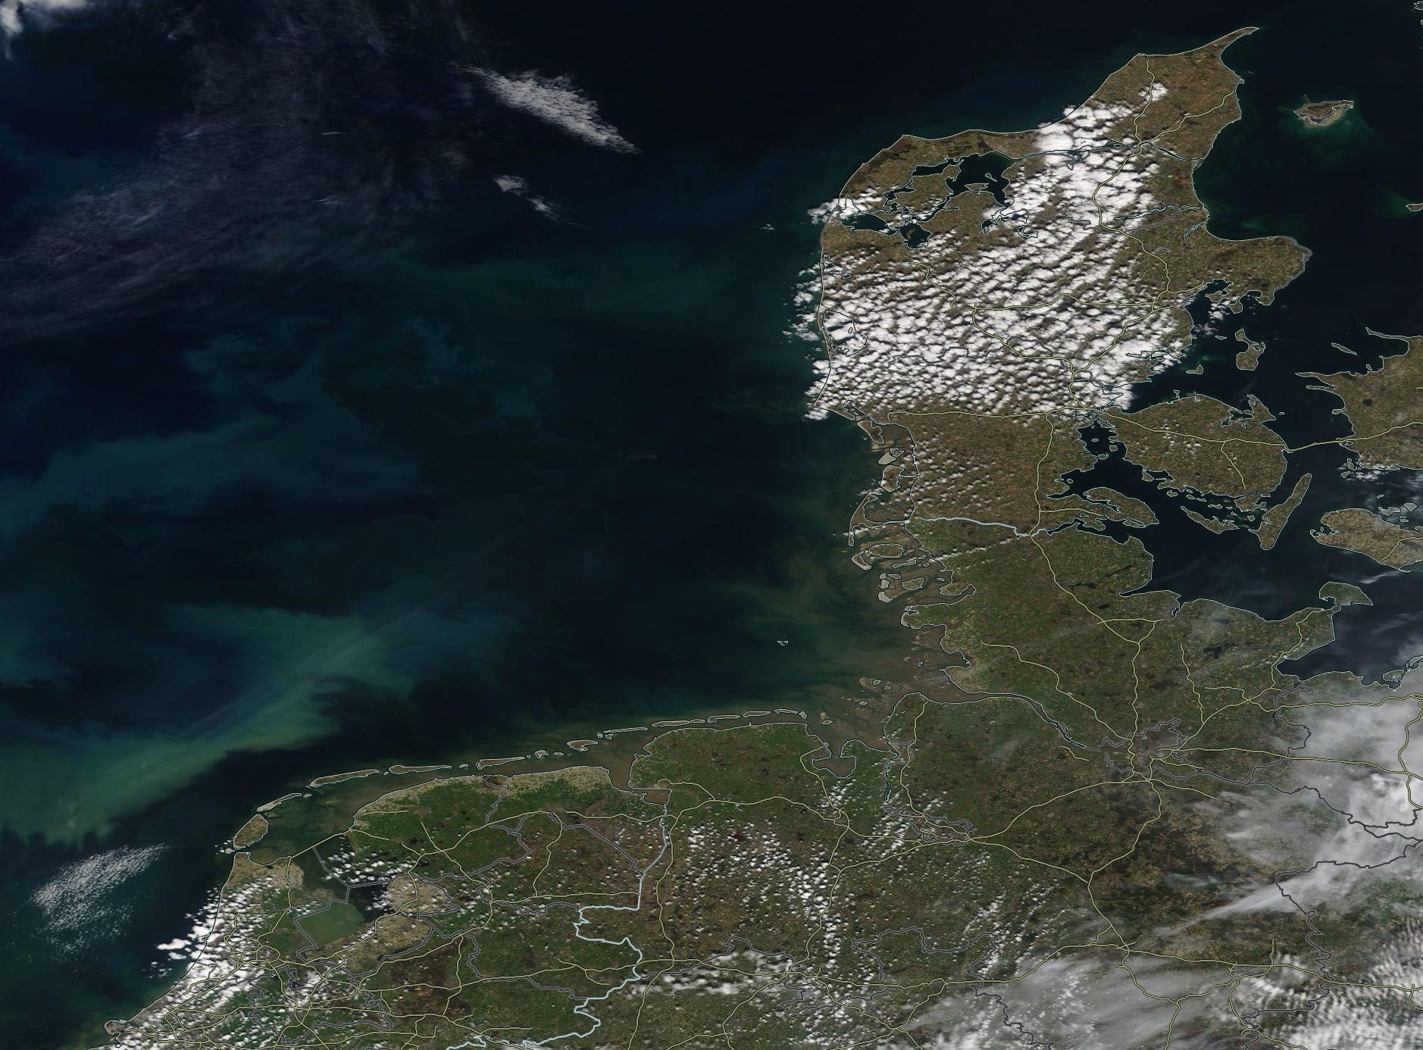
Wadden sea: April 15/16 2021
at night:
cities
ships
oil platforms/wind farms
industry/ harbors
NASA/EOSDIS
3

Slide 4
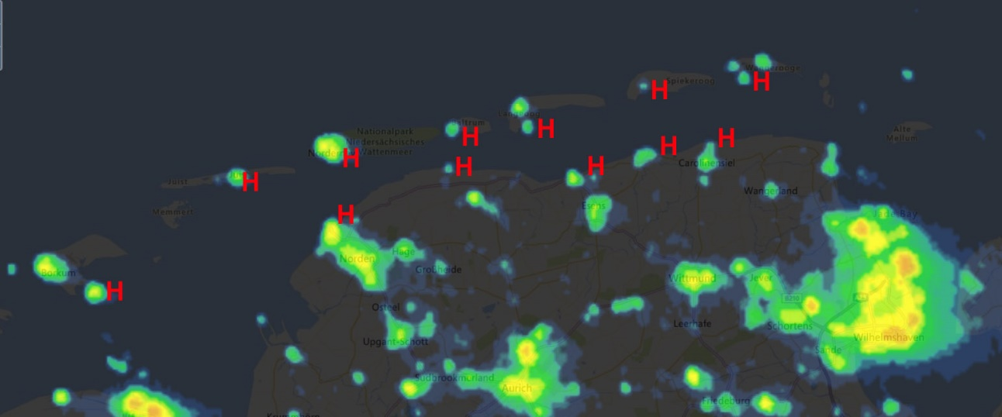
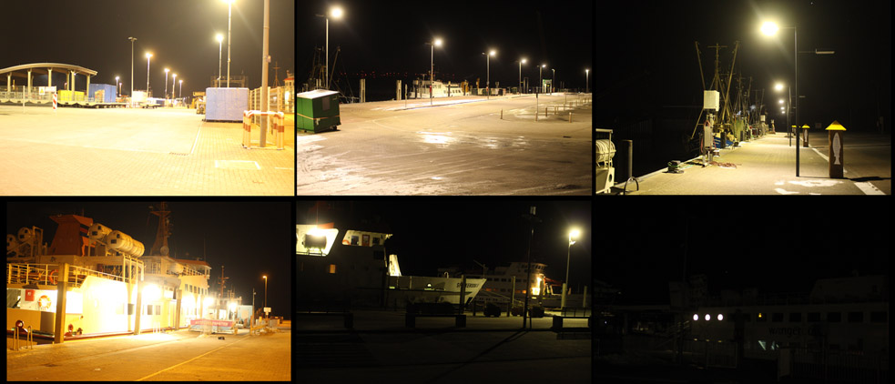
Ports Eastern Frisia
main light sources on coast (at 2 o‘clock)
connection to the islands (H – harbor)
but: no ferries at night!
Is it necessary to illuminate them all night long?
some are switched off –why not all?

Slide 5
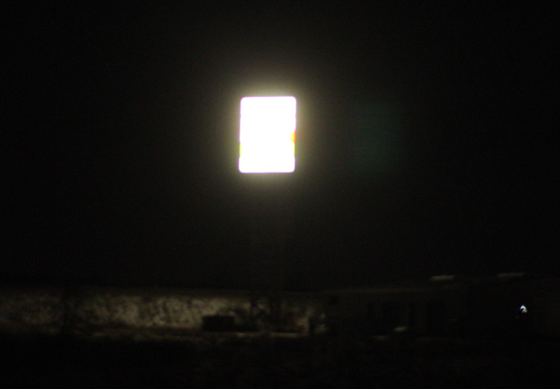
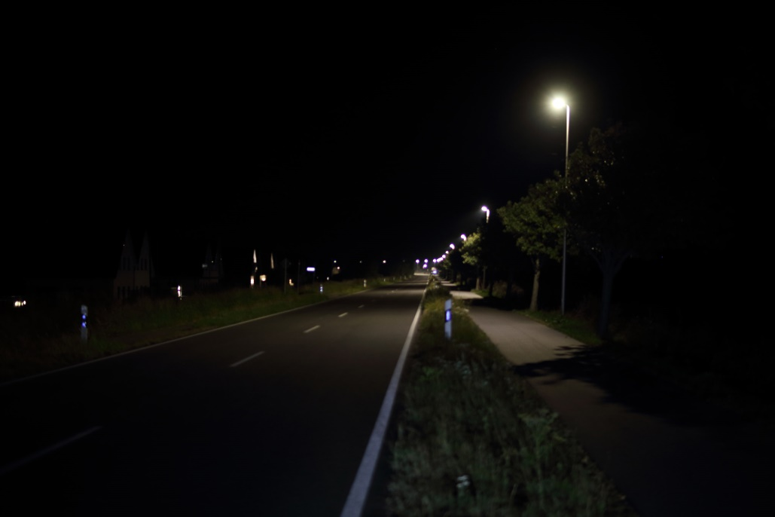
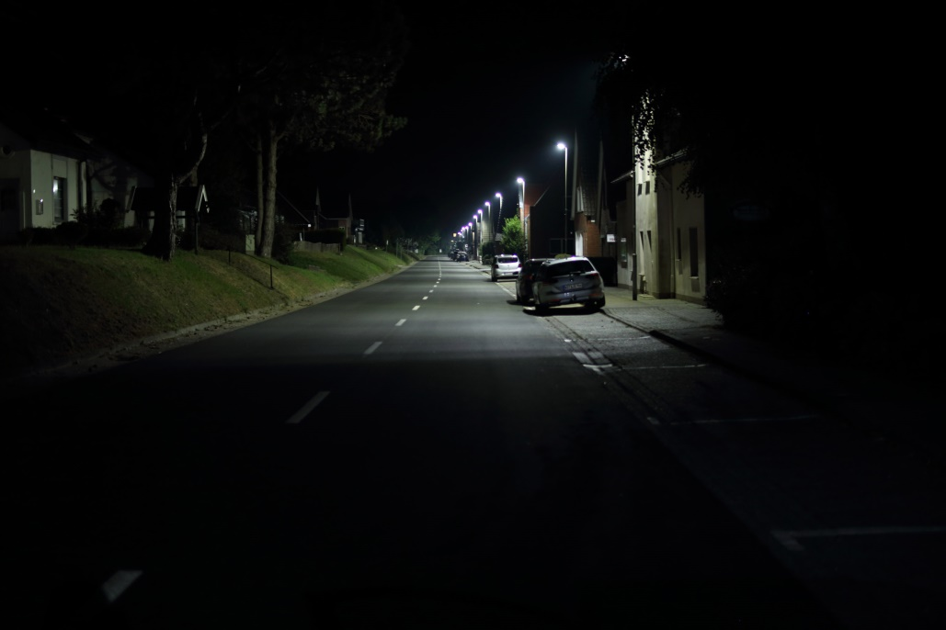
Villages
badly shielded
too bright (“light terror”)
color (insects)
within one village!
advertising all night long?
Notwendigkeit?

Slide 6
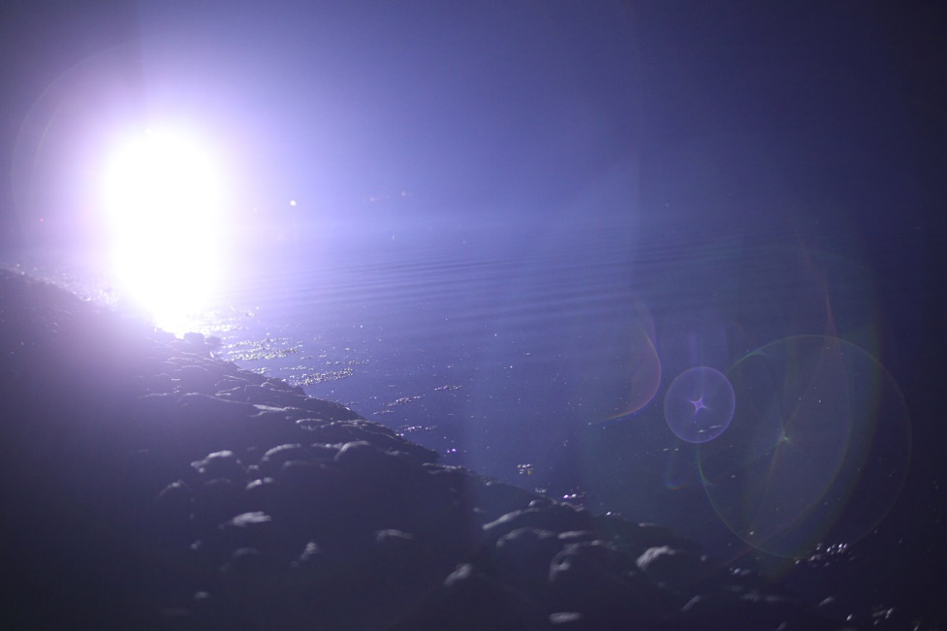
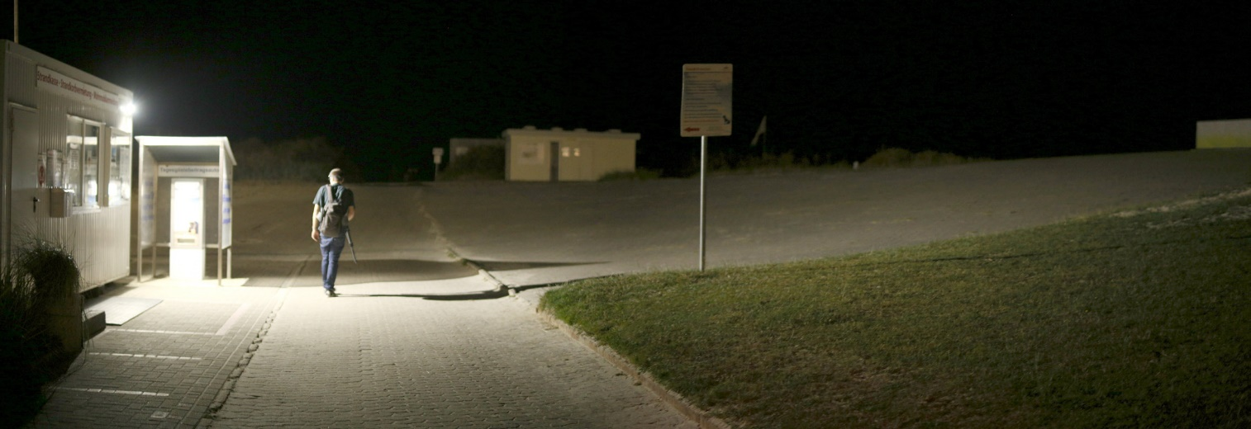
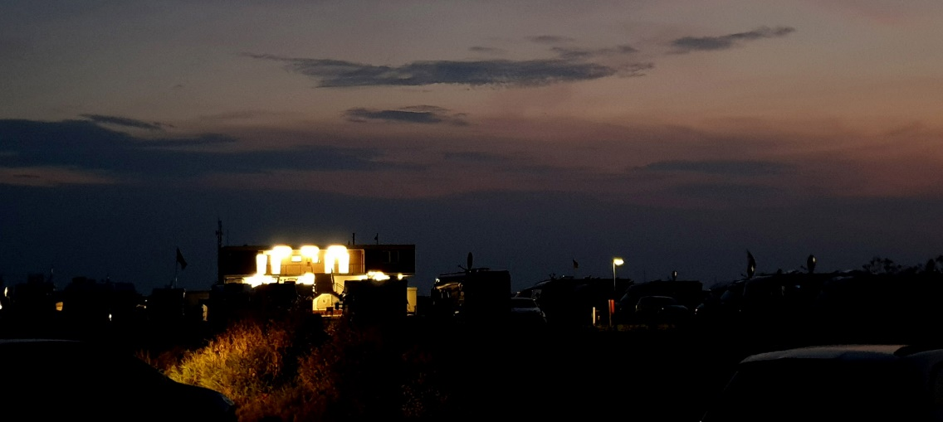
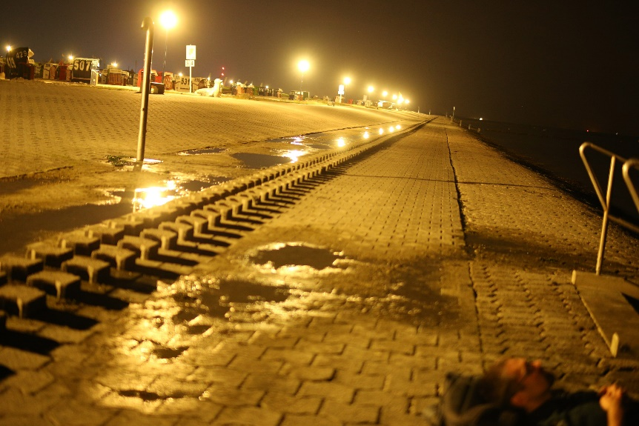
Spa villages
glaring ship
ticket booth access beach
camping toilets
beach at 1 o’clock
is this necessary?????
Notwendigkeit?

Slide 7
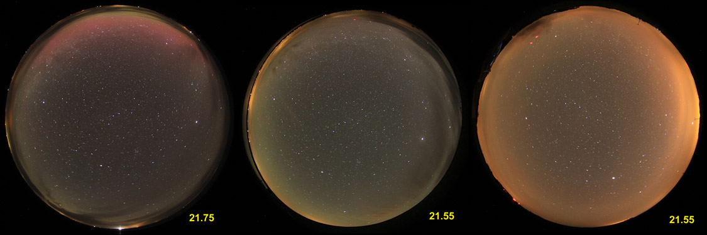
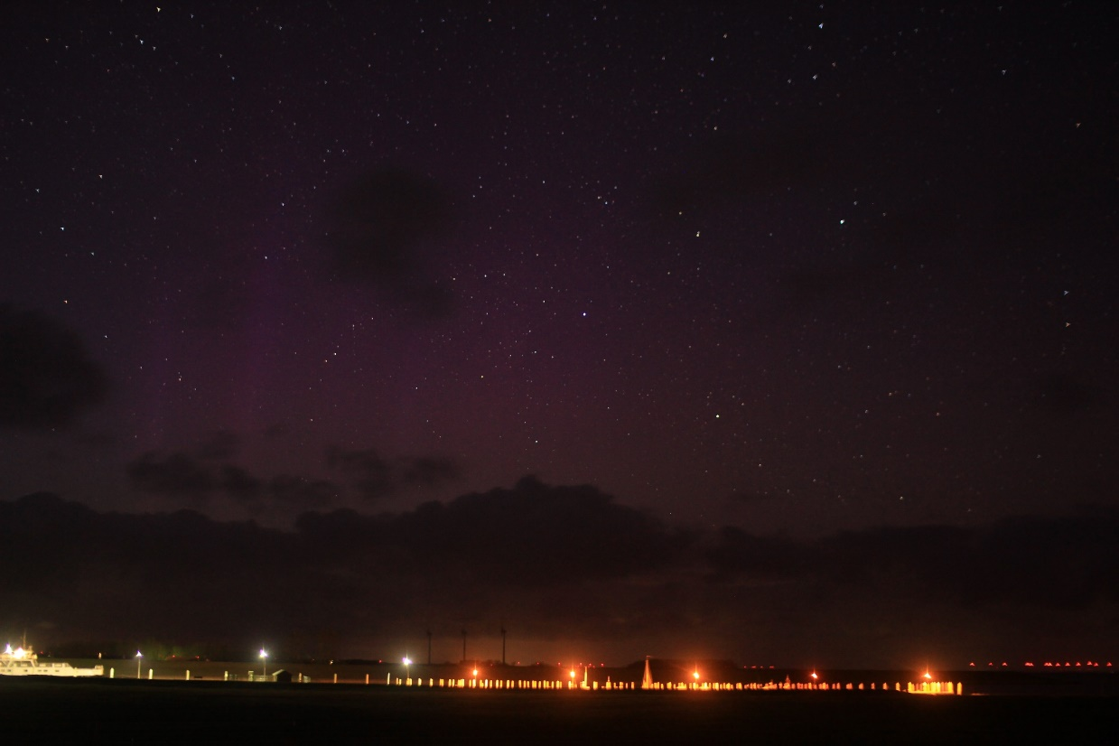
Pellworm: 3 nights in April 2015

Slide 8
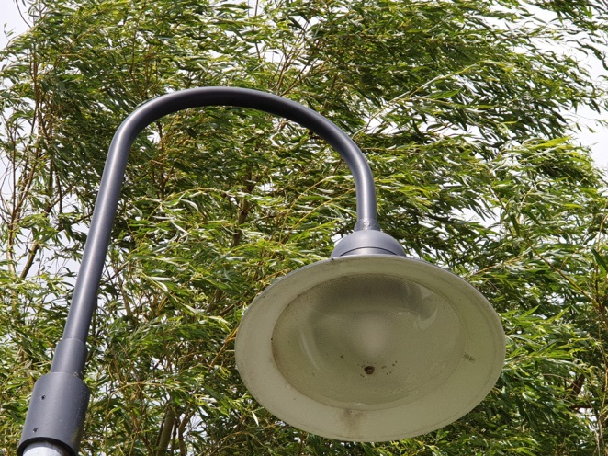
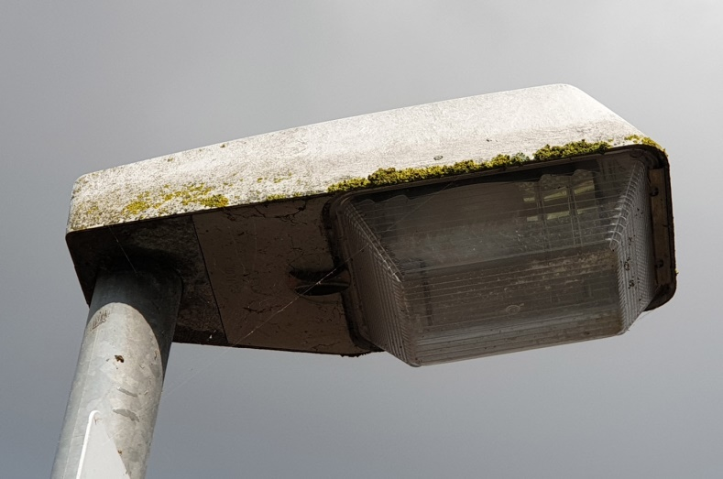
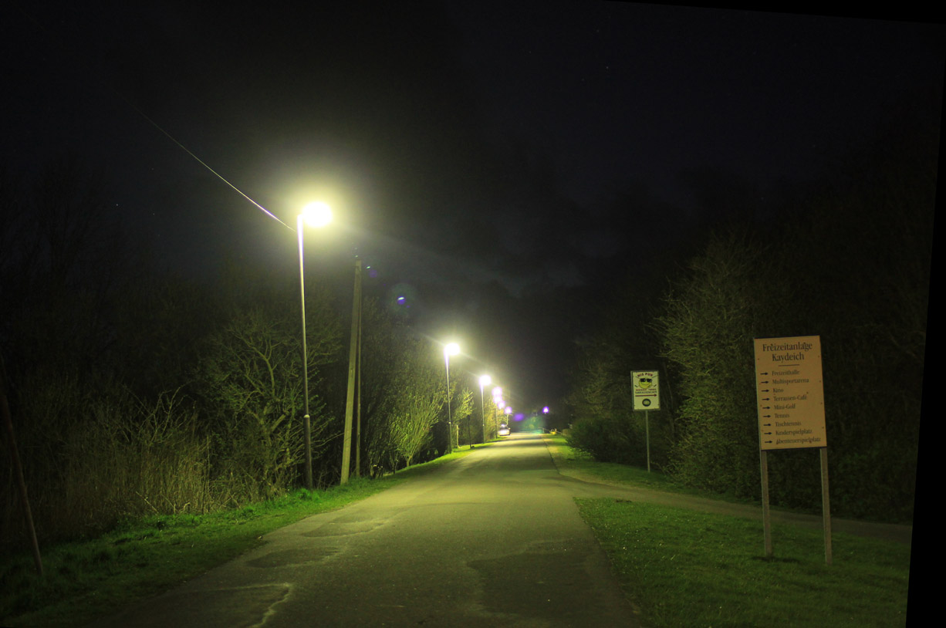
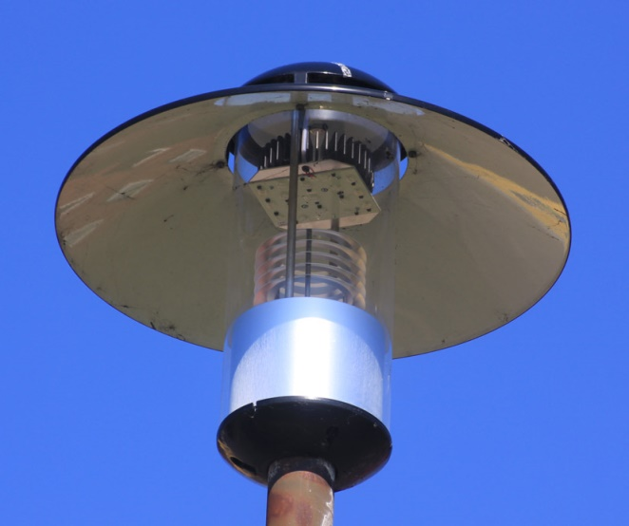
Public lighting
Full cut-off luminaires, 3000 K or less
160 lighting points
switch-off at 22:30
8

Slide 9
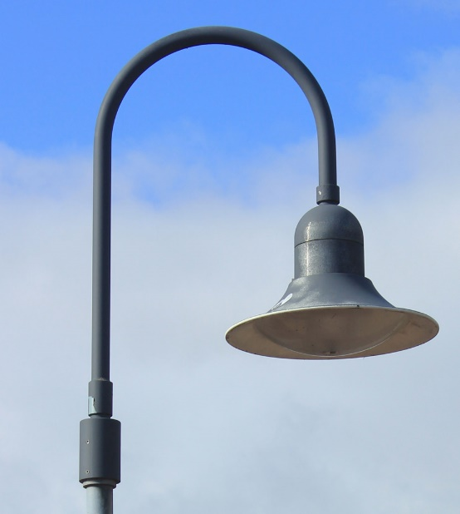

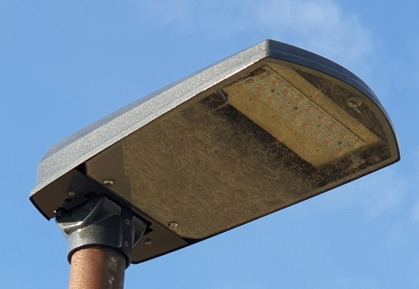
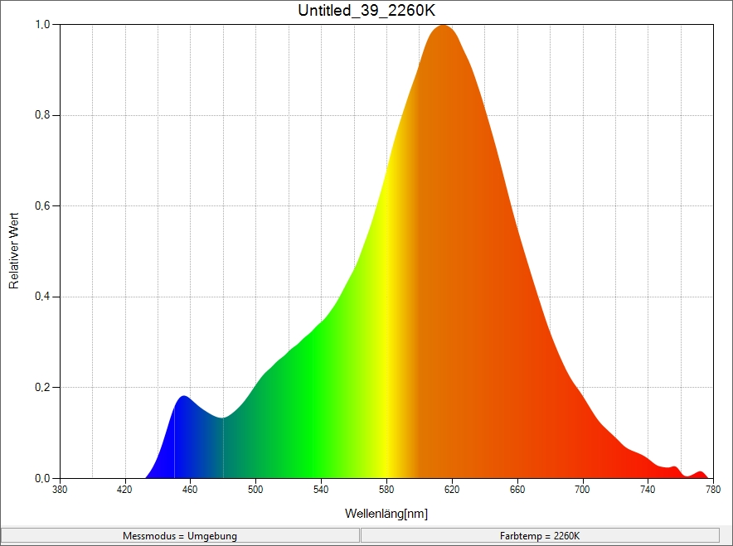
Restart in 2019
additional LEADER funding
biosphere project, sustainable tourism
exchange of 64 luminaires, 69 lamps
color temperature
2200 K (ultra warm white)
insect friendly!
low light flux:
1000/1200, 5000 lm
switch-off 22:00
9

Slide 10
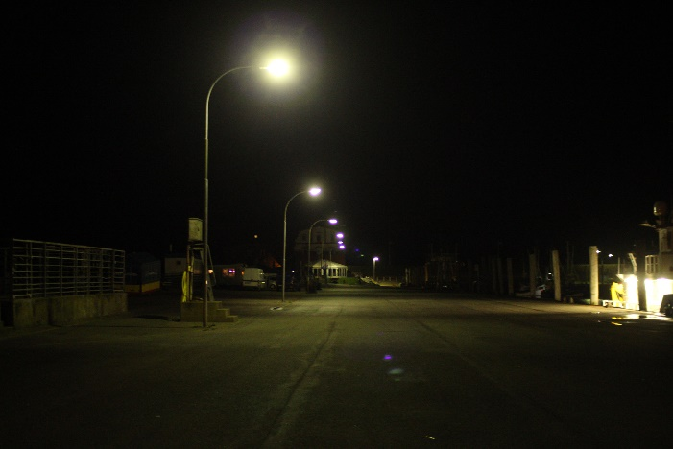
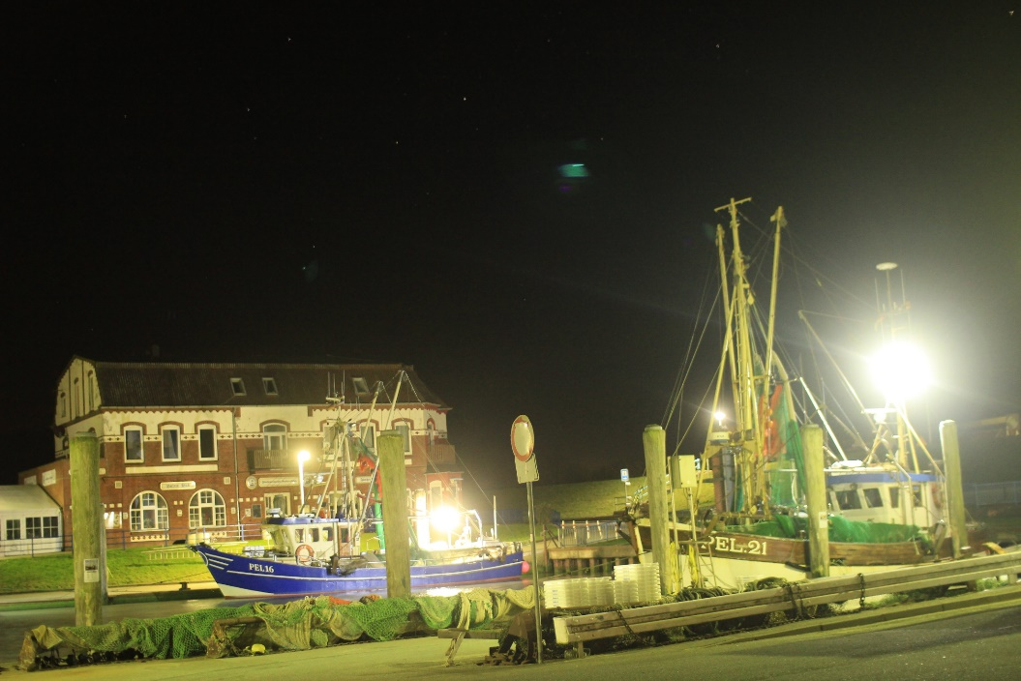
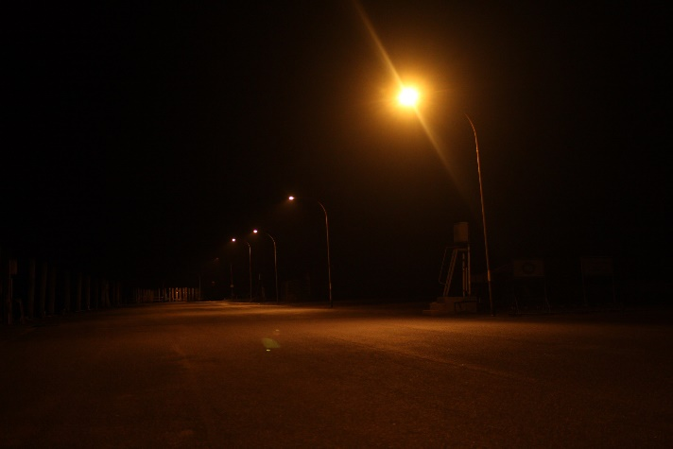
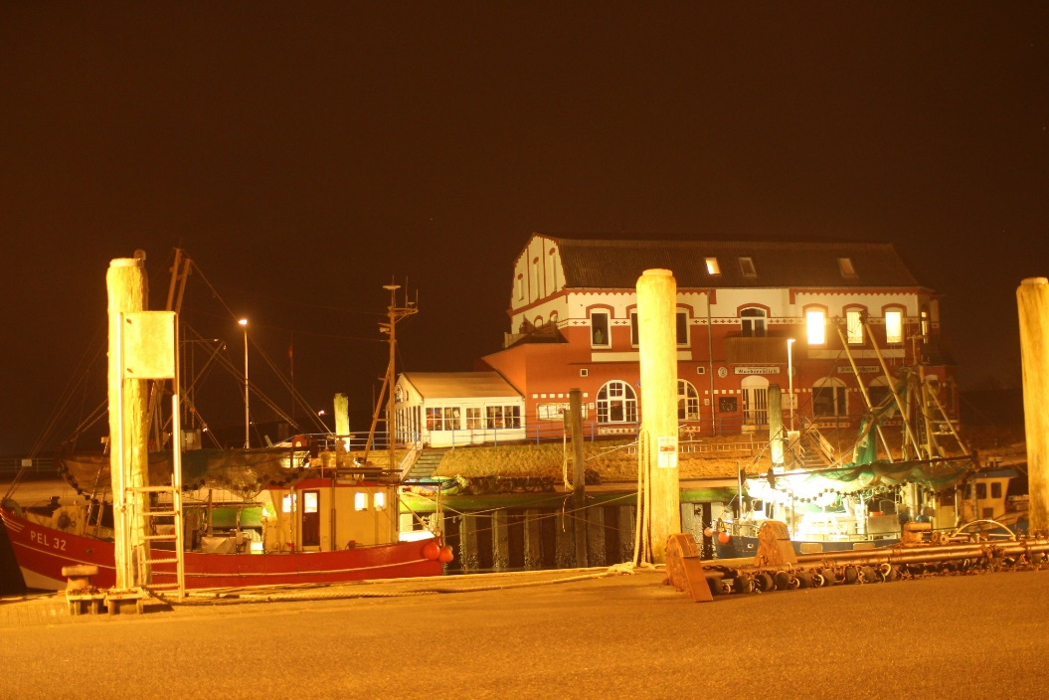
Pellworm old harbor
10

Slide 11
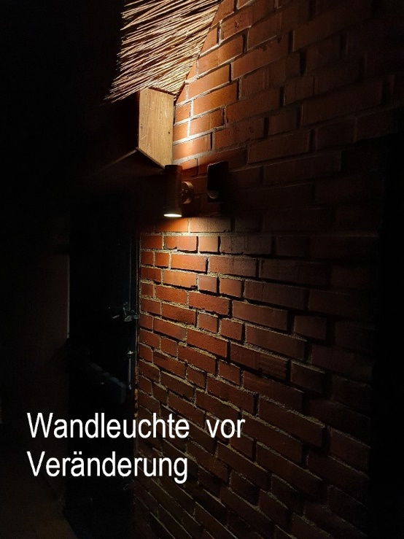
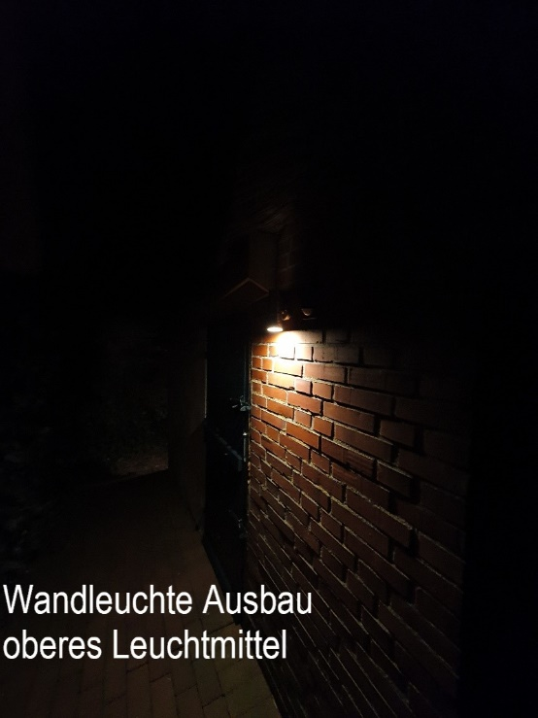
Pellworm private retrofit
11

Slide 12
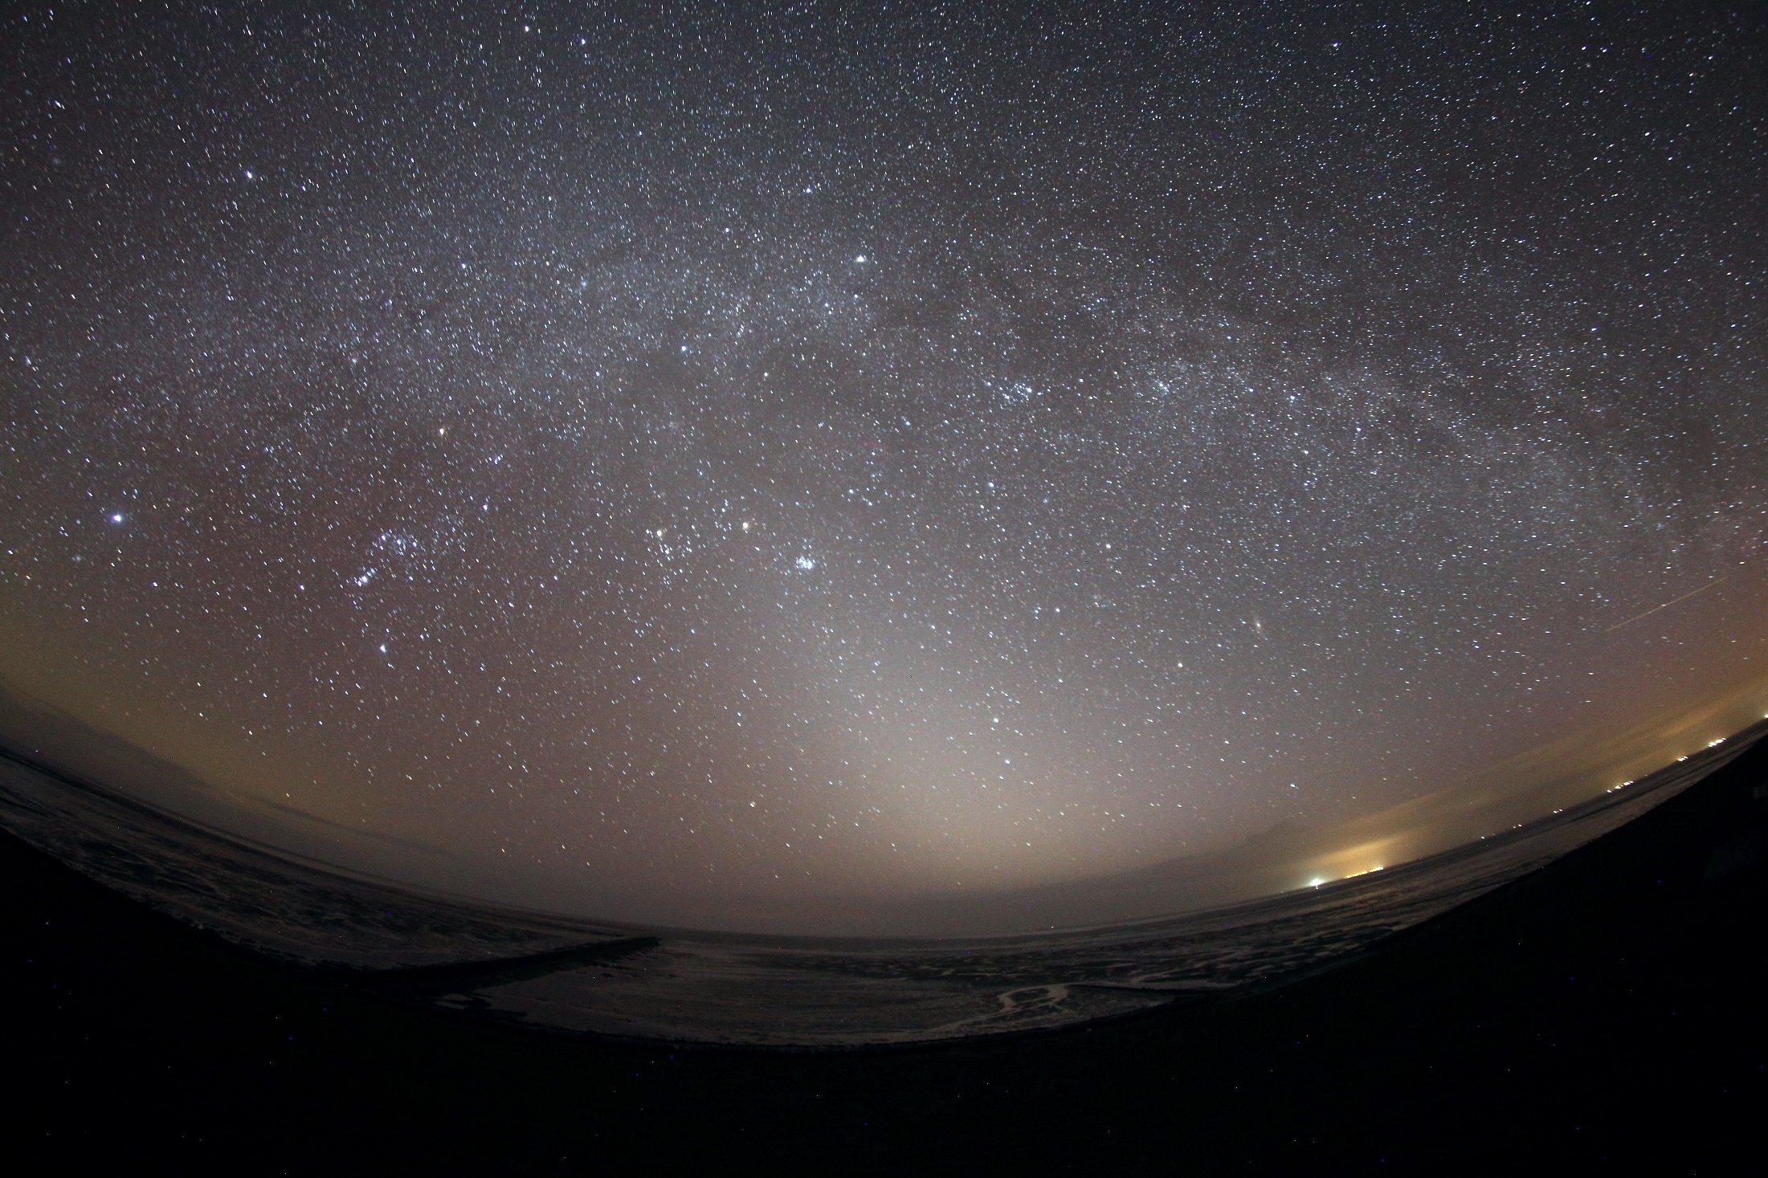
Pellworm: Zodiacal light

Slide 13
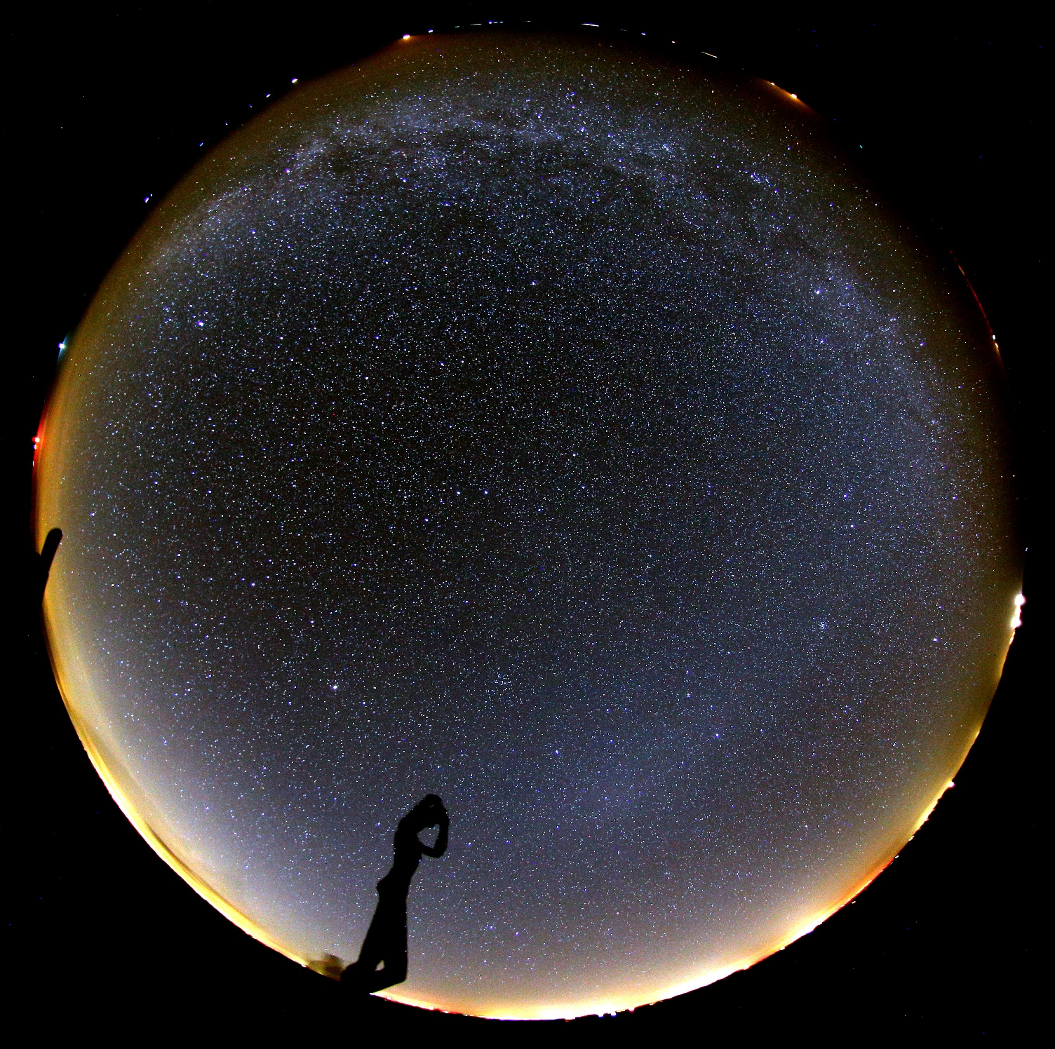
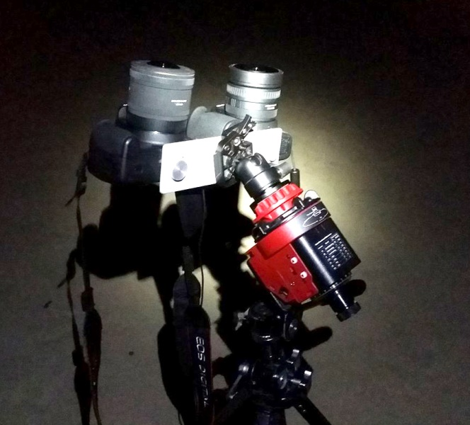
Spiekeroog:
darkest sky
Utkieker looking at Gegenschein
13

Slide 14
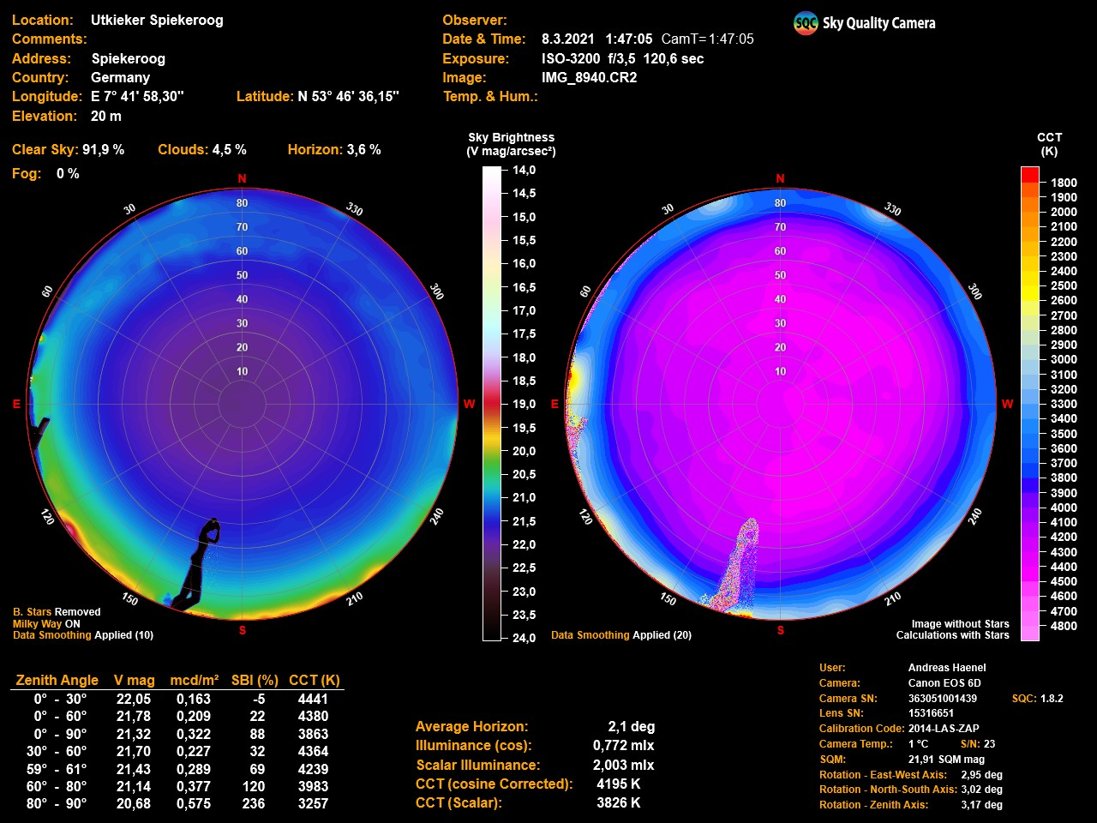
14

Slide 15
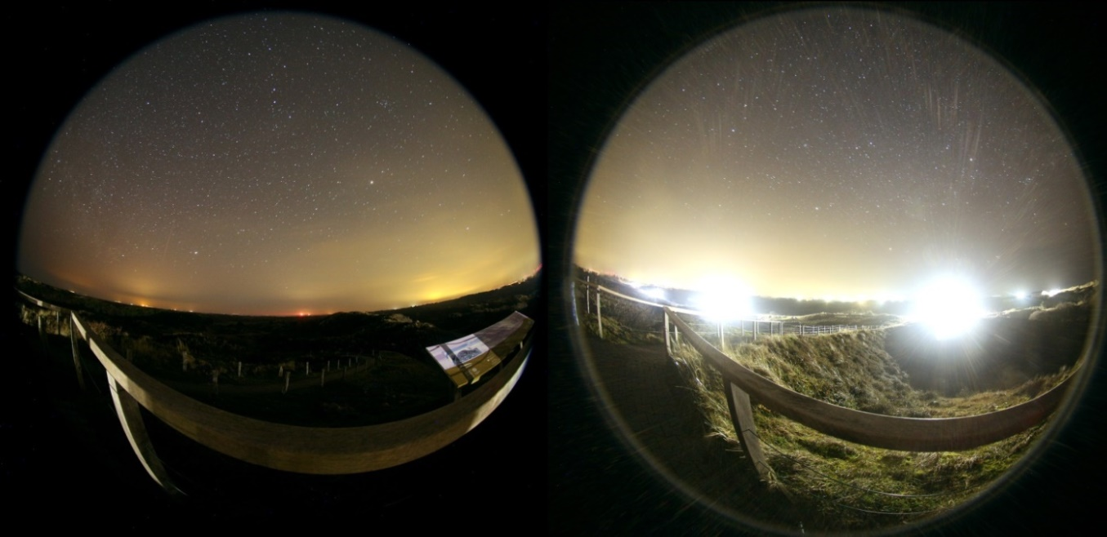
Public lighting: Slurpad, beach and Nationalpark
exchange of extremely glaring 4000 K LED
View to East Nationalpark View to West
15

Slide 16
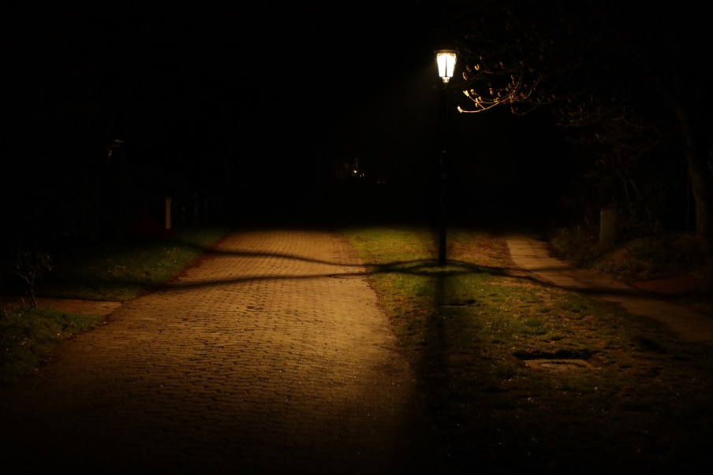
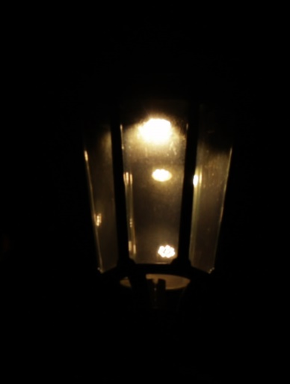
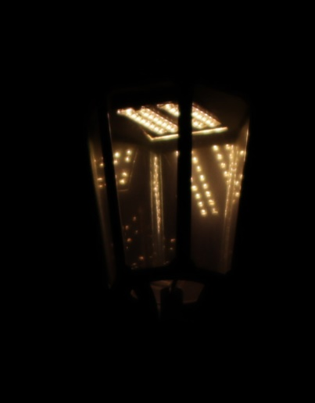
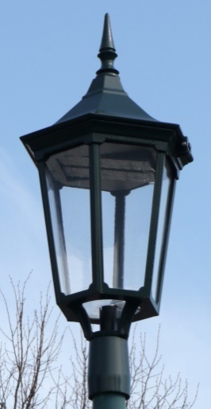
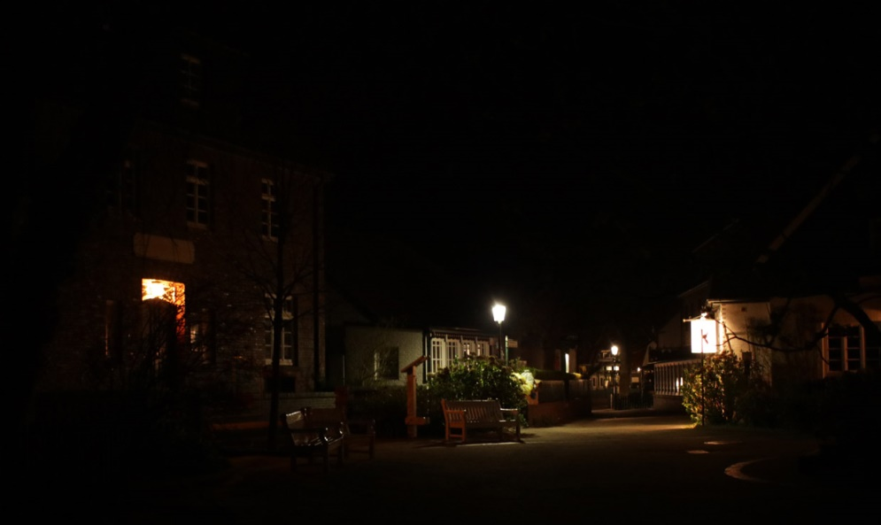
Public lighting
67 + 15 public 3000 K LED
switch-off at 0:30
EN 13201: P4 -> 5 lx mean
  former: 10 – 22 lx max.
  new: 40 – 57 max
  30% reduction: 15 – 20 lx
Problem:
uniformity 150 – 200 m distance
16

Slide 17
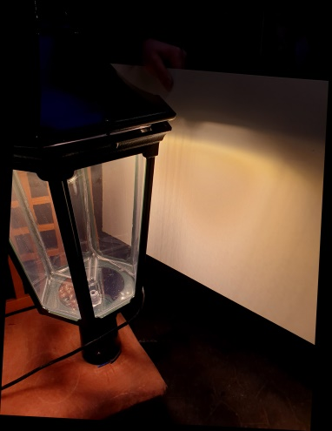
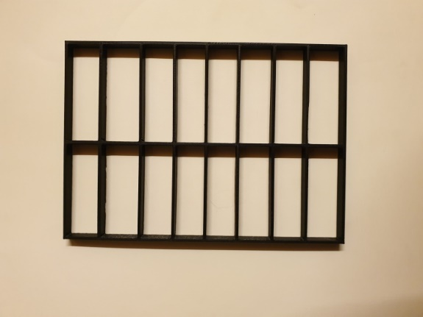
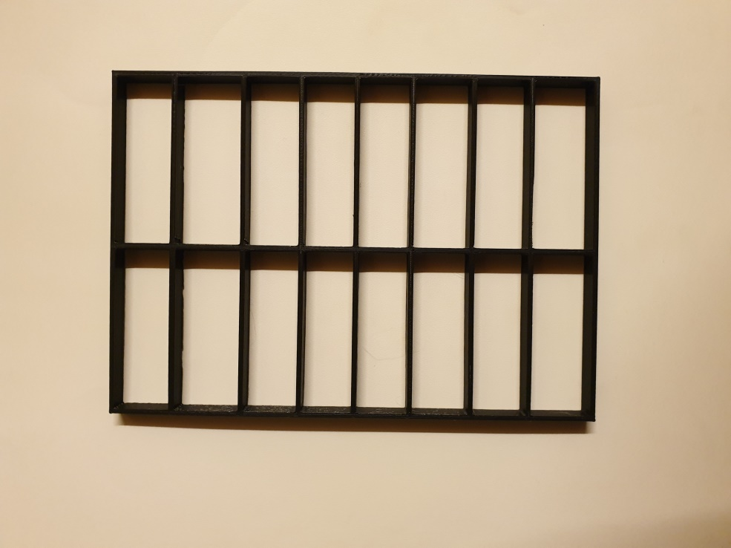
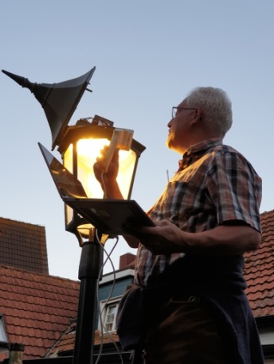
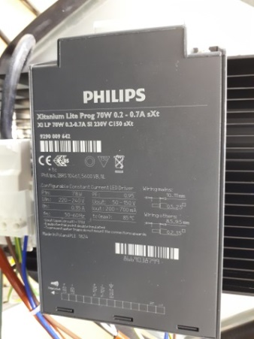
Public lighting
reducing glare
by a simple method
solution:
3300 lm -> 30% -> 990 lm
17

Slide 18
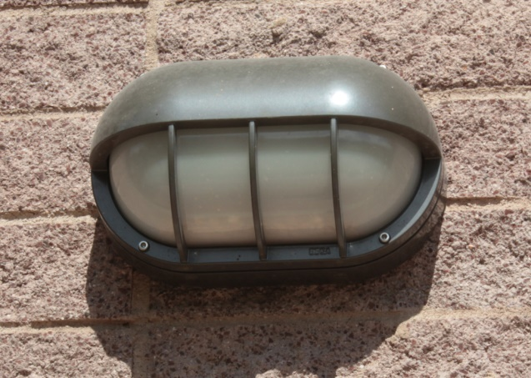
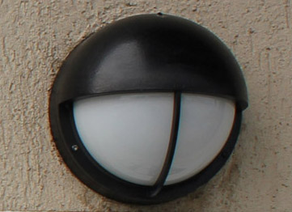
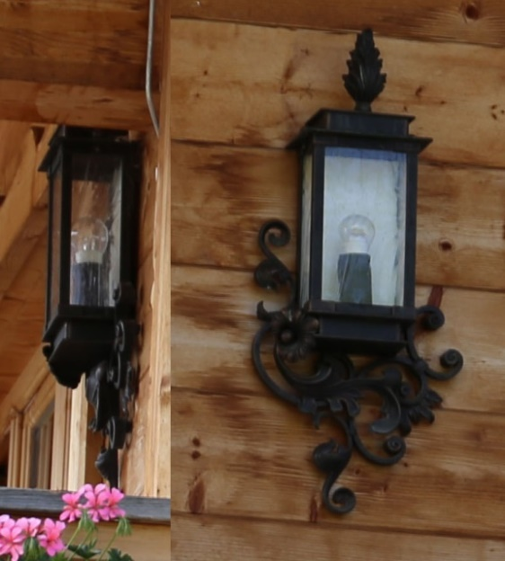
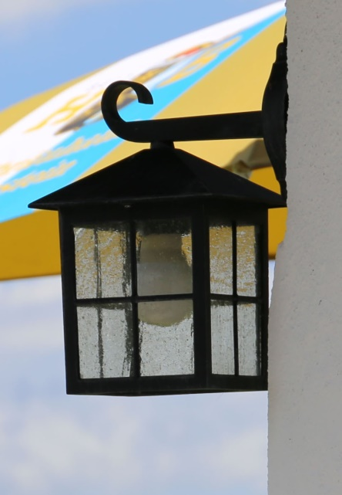
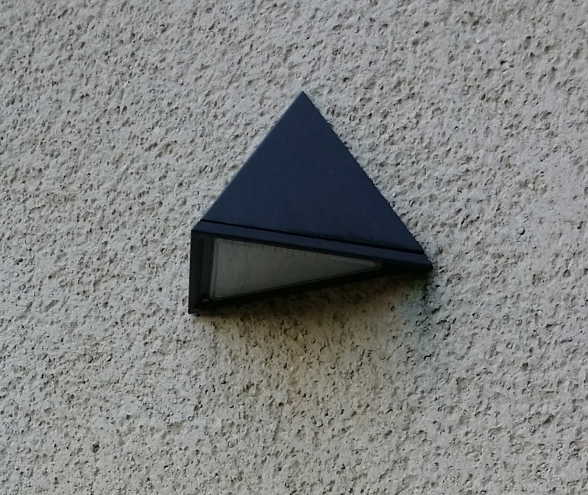
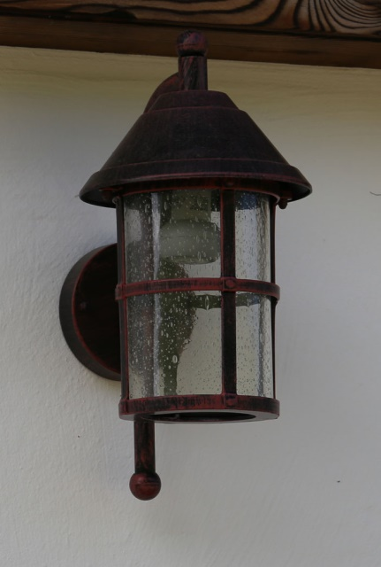
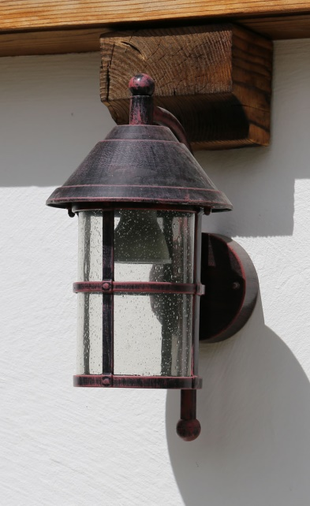

Wall fixtures
not shielded

Slide 19





Flood lights
mount horizontally
max. 800 lm
≤ 3000 K

Slide 20



Private luminaires (garden)
Solar lamps
hazardous waste
30 lx on soil!
max. 3000 K
use motion detector control!
avoid these luminaires!

Slide 21


Illuminated ships
sailing
parking
Spiekeroog with comet NEOWISE

Slide 22
Sustainable lighting
Is artifial light necessary?
- prefer no light!
How much light is necessary?
– low flux!
Where is the light necessary?
– shield light!
When is light necessary?
– reduce, adaptive!
Which quality of light?
– low blue content!
Notwendigkeit?

Slide 23

Sustainable lighting
saves money
is good for environment
is good for health
is easy
so: let’s do it!
Notwendigkeit?

Slide 24


Thank you very much for your attention!
ahaenel@uos.de

